Slide 1

Placement Review
Scanmetals UK LTD
PPY5004 PROFESSIONAL PLACMENENT YEAR A AYR 2025/6
Kacper Popis
23161791
Birmingham City University
kacper.popis@mail.bcu.ac.uk

Slide 2
Placement Background
Name: Scanmetals UK LTD
  28 Bilston Ln, Willenhall WV13 2QE
Placement Job Title: Document Control Assistant & IT Administrator / Developer
  Report To Kieron Walsh (Document Controller / Compliance Administrator)
Employment: Started working on 18/08/2025
  Still working with the company to this day

Slide 3
Placement Background
Scanmetals is a leader in the recovery of non-ferrous metal from incinerator bottom ash (IBA). The recovered non-ferrous metals are cleaned, separated into different fractions and sold to primary and secondary smelters, refineries, ingot makers and foundries globally.
Currently Scanmetals operates within the following countries: Denmark, United Kingdom, German & Spain. I’m situated within the UK site, but I have worked alongside and assisted in works with all sites – be that in meetings or working on projects.
The IT is managed by an external company called Zentura, a company in Denmark, which have grown alongside the company and manage our Azure, Microsoft and Cloud environment. And as a part of my role, I’ve been working alongside them, and even getting assistance with in-house projects.

Slide 4
Roles & Responsibilities
Roles
Responsibilities
Document Controller
  Review the changes made by process owners on draft documents
  Finalise documents into our IMS which then get published to different sectors of the company for employees to utilise
IT Administrator
  Review currently used systems (Power Automate, Microsoft Office, SharePoint) and optimise systems to perform more efficiently
  Introduce new software (Talent LMS, Talent HR) to the business, and assist in day-to-day operations on these systems
  Monitor IT stock (phones, laptops, tablets, monitors, docking station, IT consumables) on our CMMS (ShireSystem) software
  Created new processes within the company (IT Ticket system, CCTV request system)
Developer
  Leading IT projects
  Developing new systems by utilising various programming languages (PHP, HTML, JS, SQL), and integrating applications (like SharePoint) using the Graph API
Create clear and accurate SOP’s (Standard Operational Procedures) on how to operate current systems and how newly implemented features work
Design software and systems to replace current processes, to innovate and streamline work across the business
Respond to all IT tickets submitted by users internally. Ensuring that there is a ticket for every issue that arises, provide clear comments about actions taken and storing them within the ticketing system. Communicating throughout with the user to ensure the quickest and most suitable fix is found
Project lead for internal IT projects such as patching in a newly acquired office to ensure all users are connected to the correct network, and all ethernet sockets are functional

Slide 5
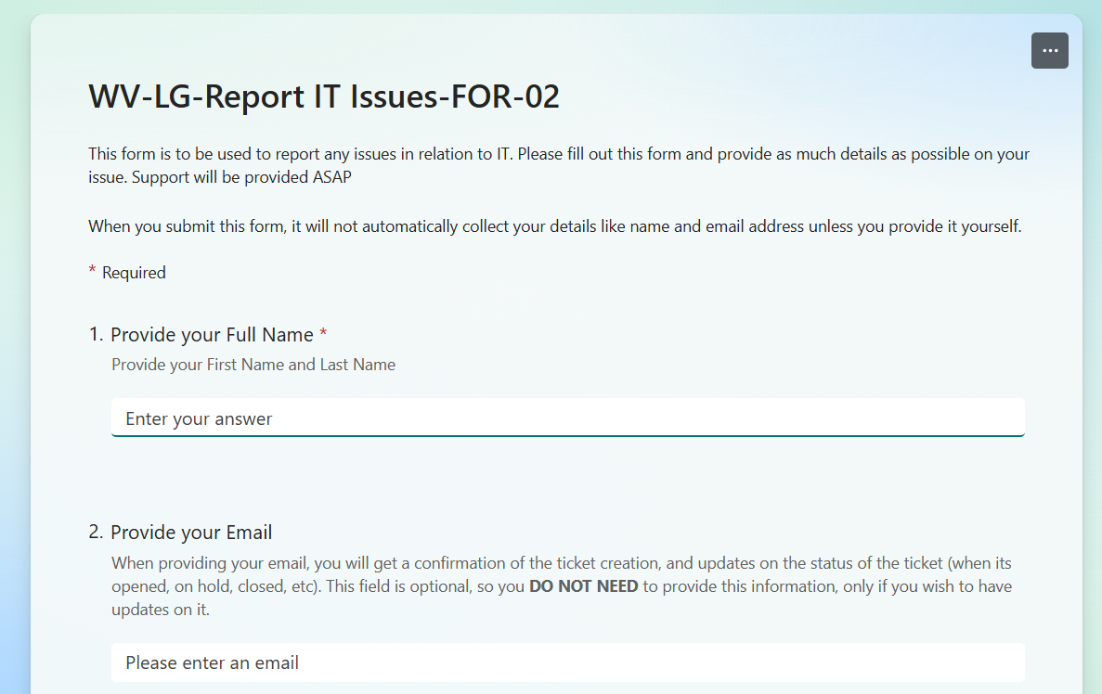
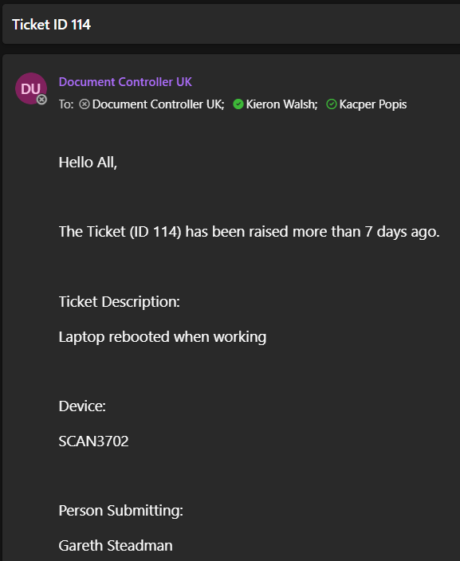
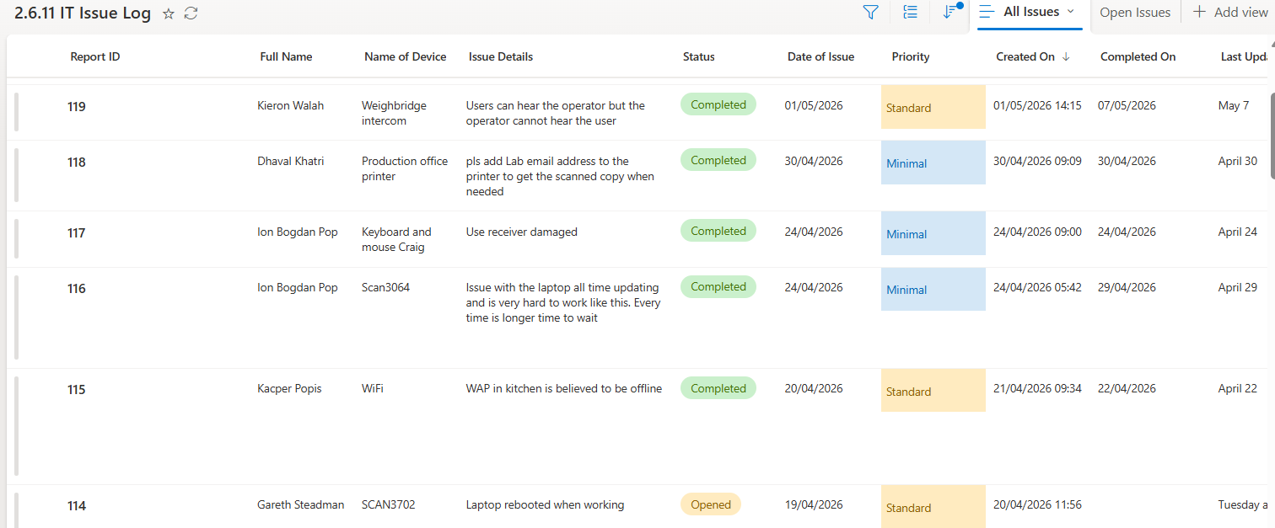
IT Ticketing System
Microsoft Form to submit ticket
Ticket reminder email sent out
List of all raised IT Tickets

Slide 6
Key Challenges
During my time at Scanmetals I faced many challenges, especially during the start of developing my own projects
The company’s IT is managed by an external company, so majority of access was restricted, or some things (like hosting an Apache service) wasn’t possible without talking it over with the IT company
As my role progressed, I had to work more with senior management, which took time to adjust and to and gain the courage to speak up
Being the only person within the company to run the day-to-day IT operations proved more difficult, as there wasn’t resources to use for support

Slide 7
Key Achievements
Developed, tested and released my first version of a locally hosted application, which utilised various programming languages like PHP, JavaScript, HTML, and working with external modules / packages (pdfgen) to develop a functional induction application, that can be utilised on the entire company network
Took on the role of setting up the network in a newly acquired office, this included mounting and a 24-port switch, mounting and connecting sockets into a patch panel, ensuring proper connection is applied when connecting to the patch panel, testing all sockets within the office, and ensuring devices are responsive and connected
Setting up newly acquired software like Talent LMS (Learning Management System to train current and new employees) and Talent HR (to replace our current HR system)
Assisted in internal and external audits

Slide 8
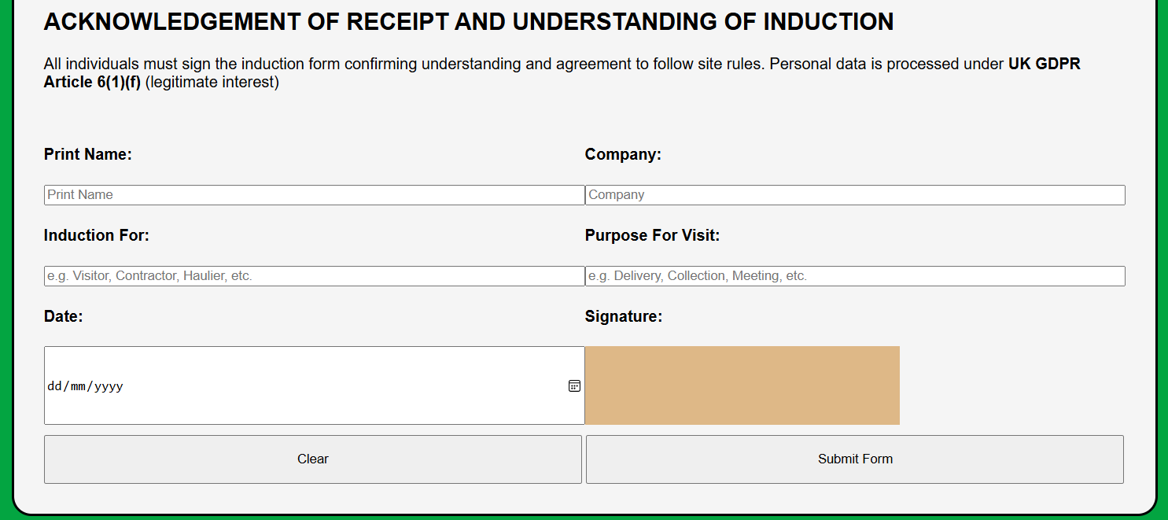
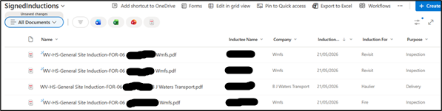
General Site Induction
Generated documents stored within SharePoint
Form users fill in to submit their induction

Slide 9
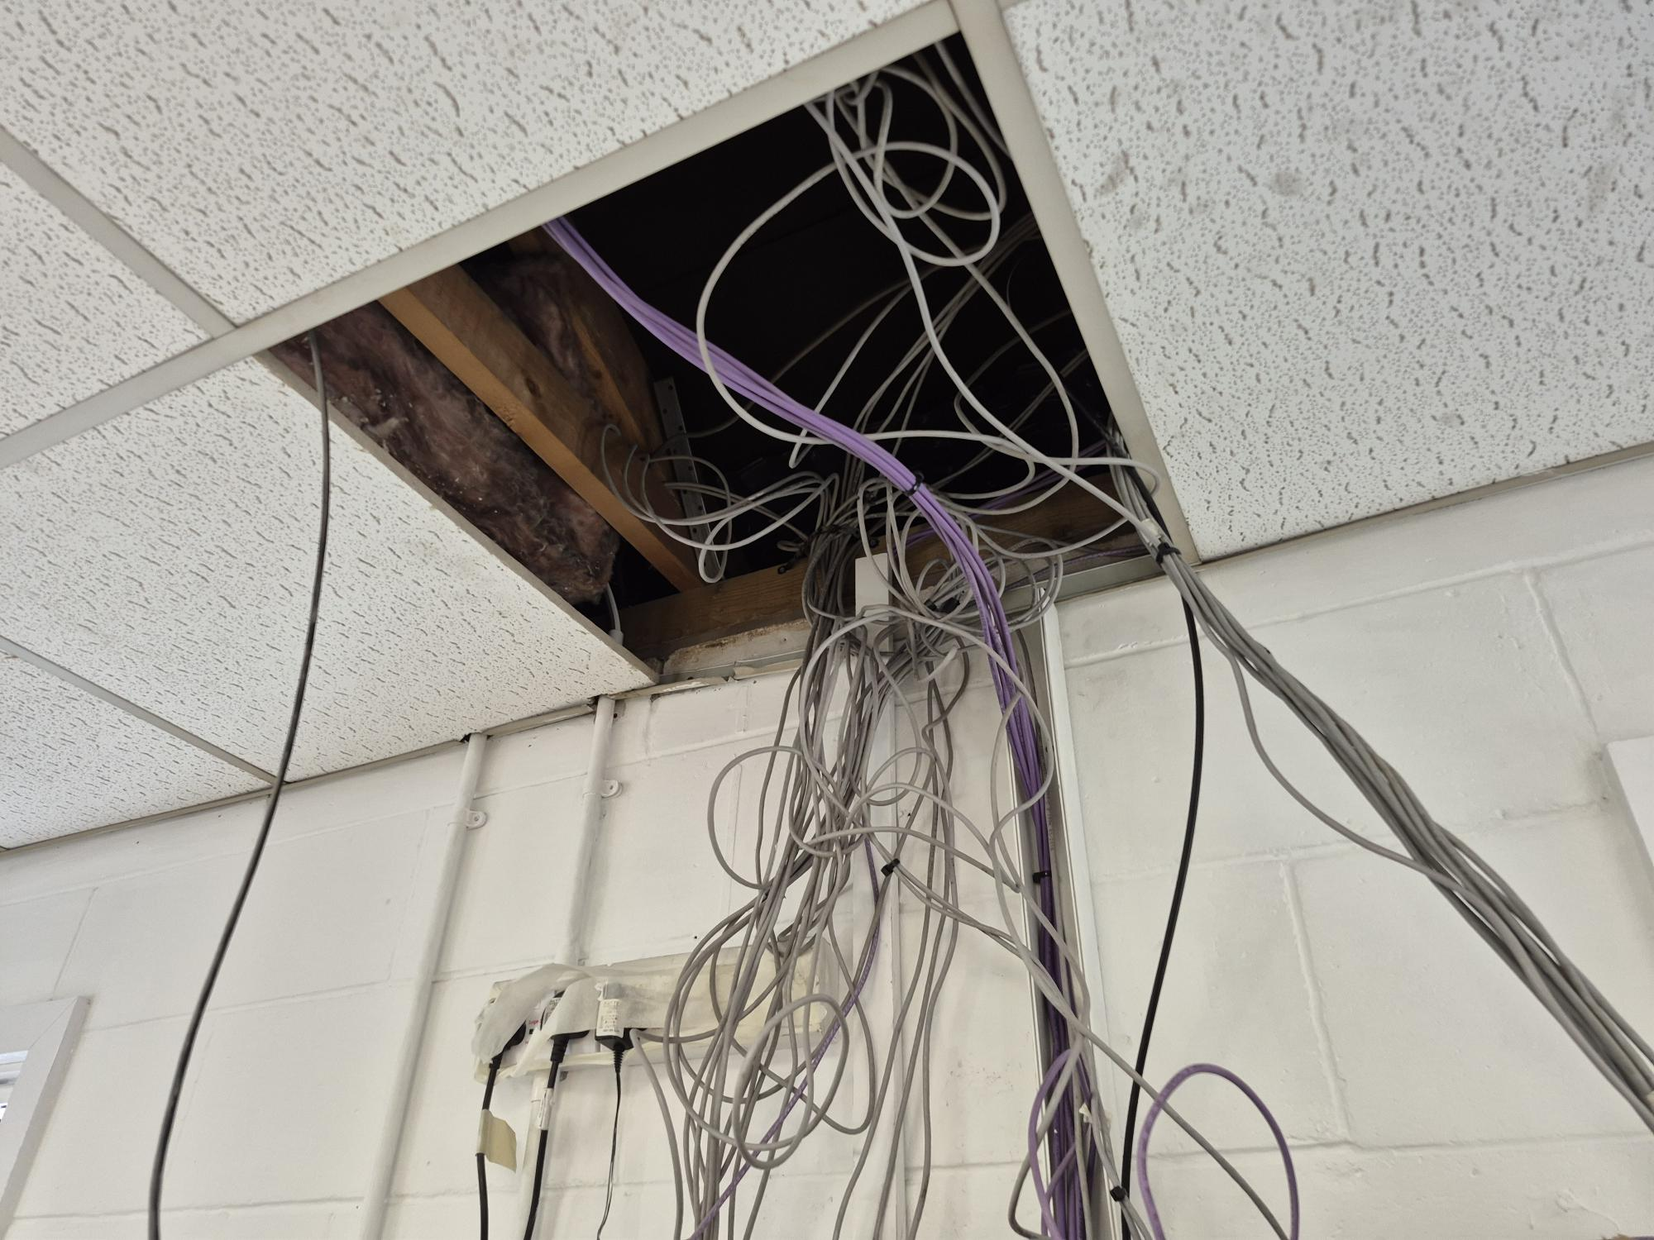
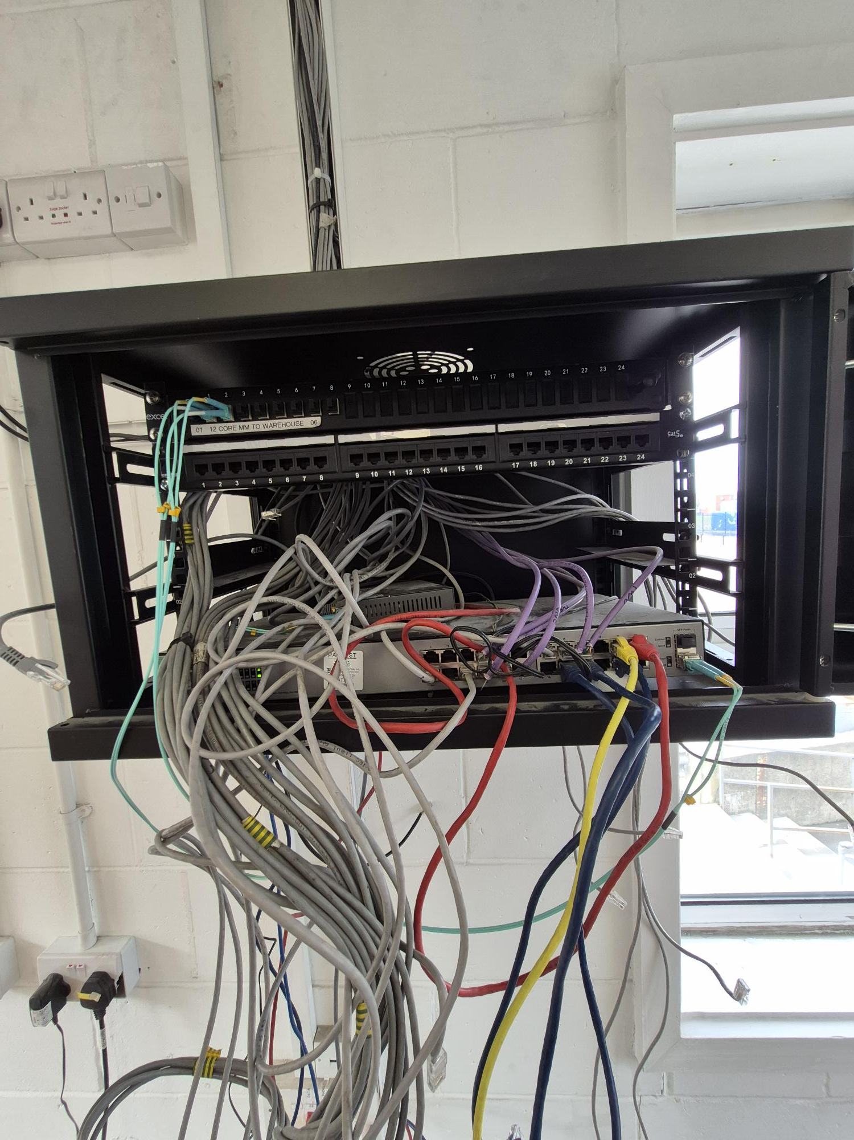
New Office - BEFORE

Slide 10
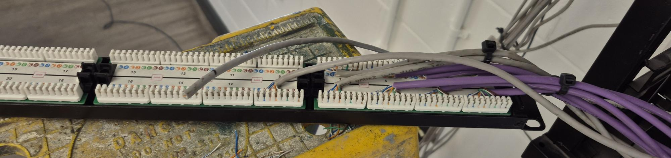
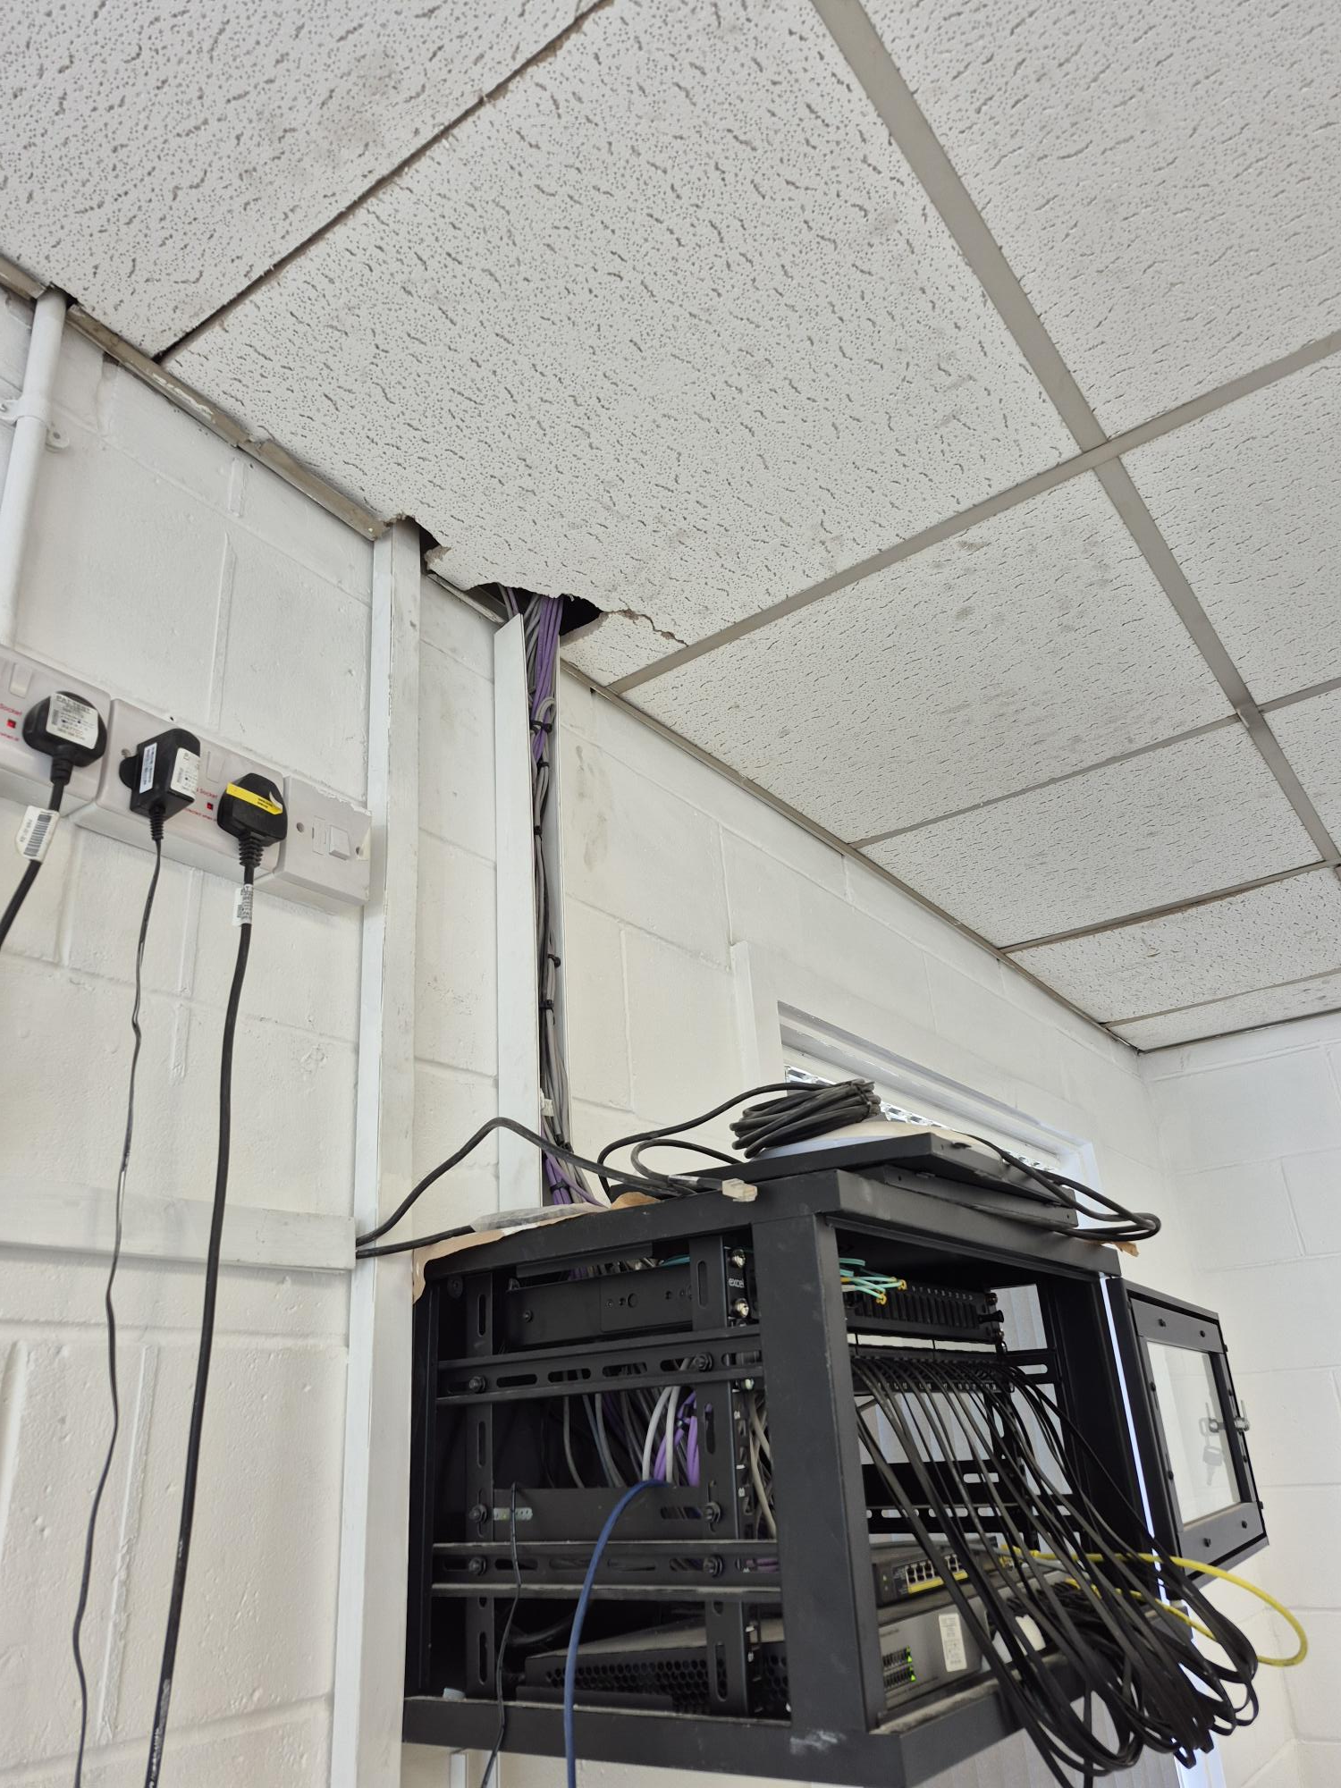
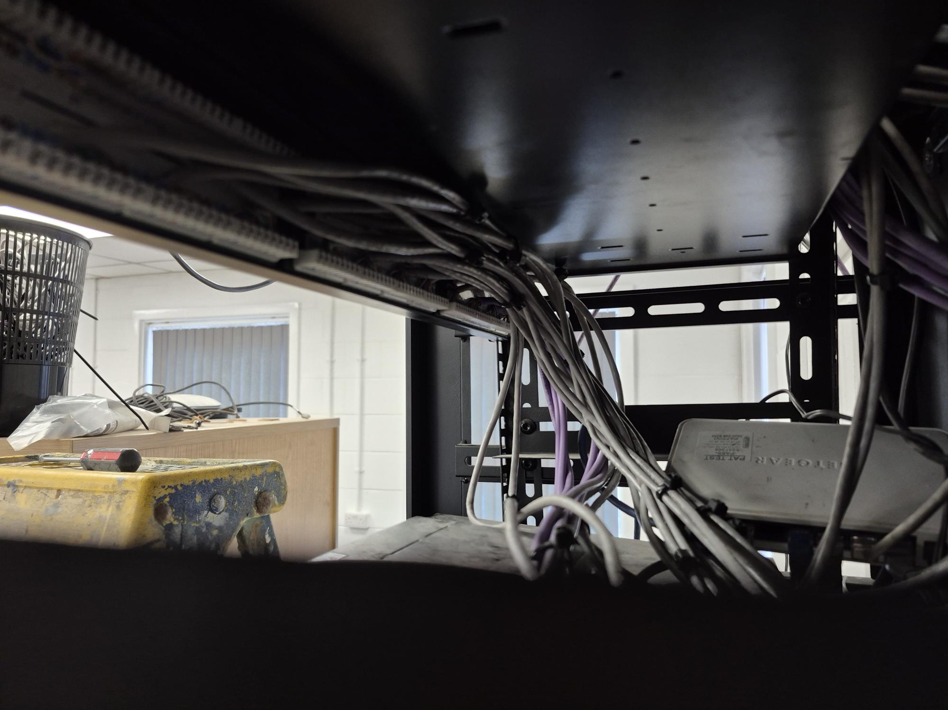
New Office - AFTER

Slide 11
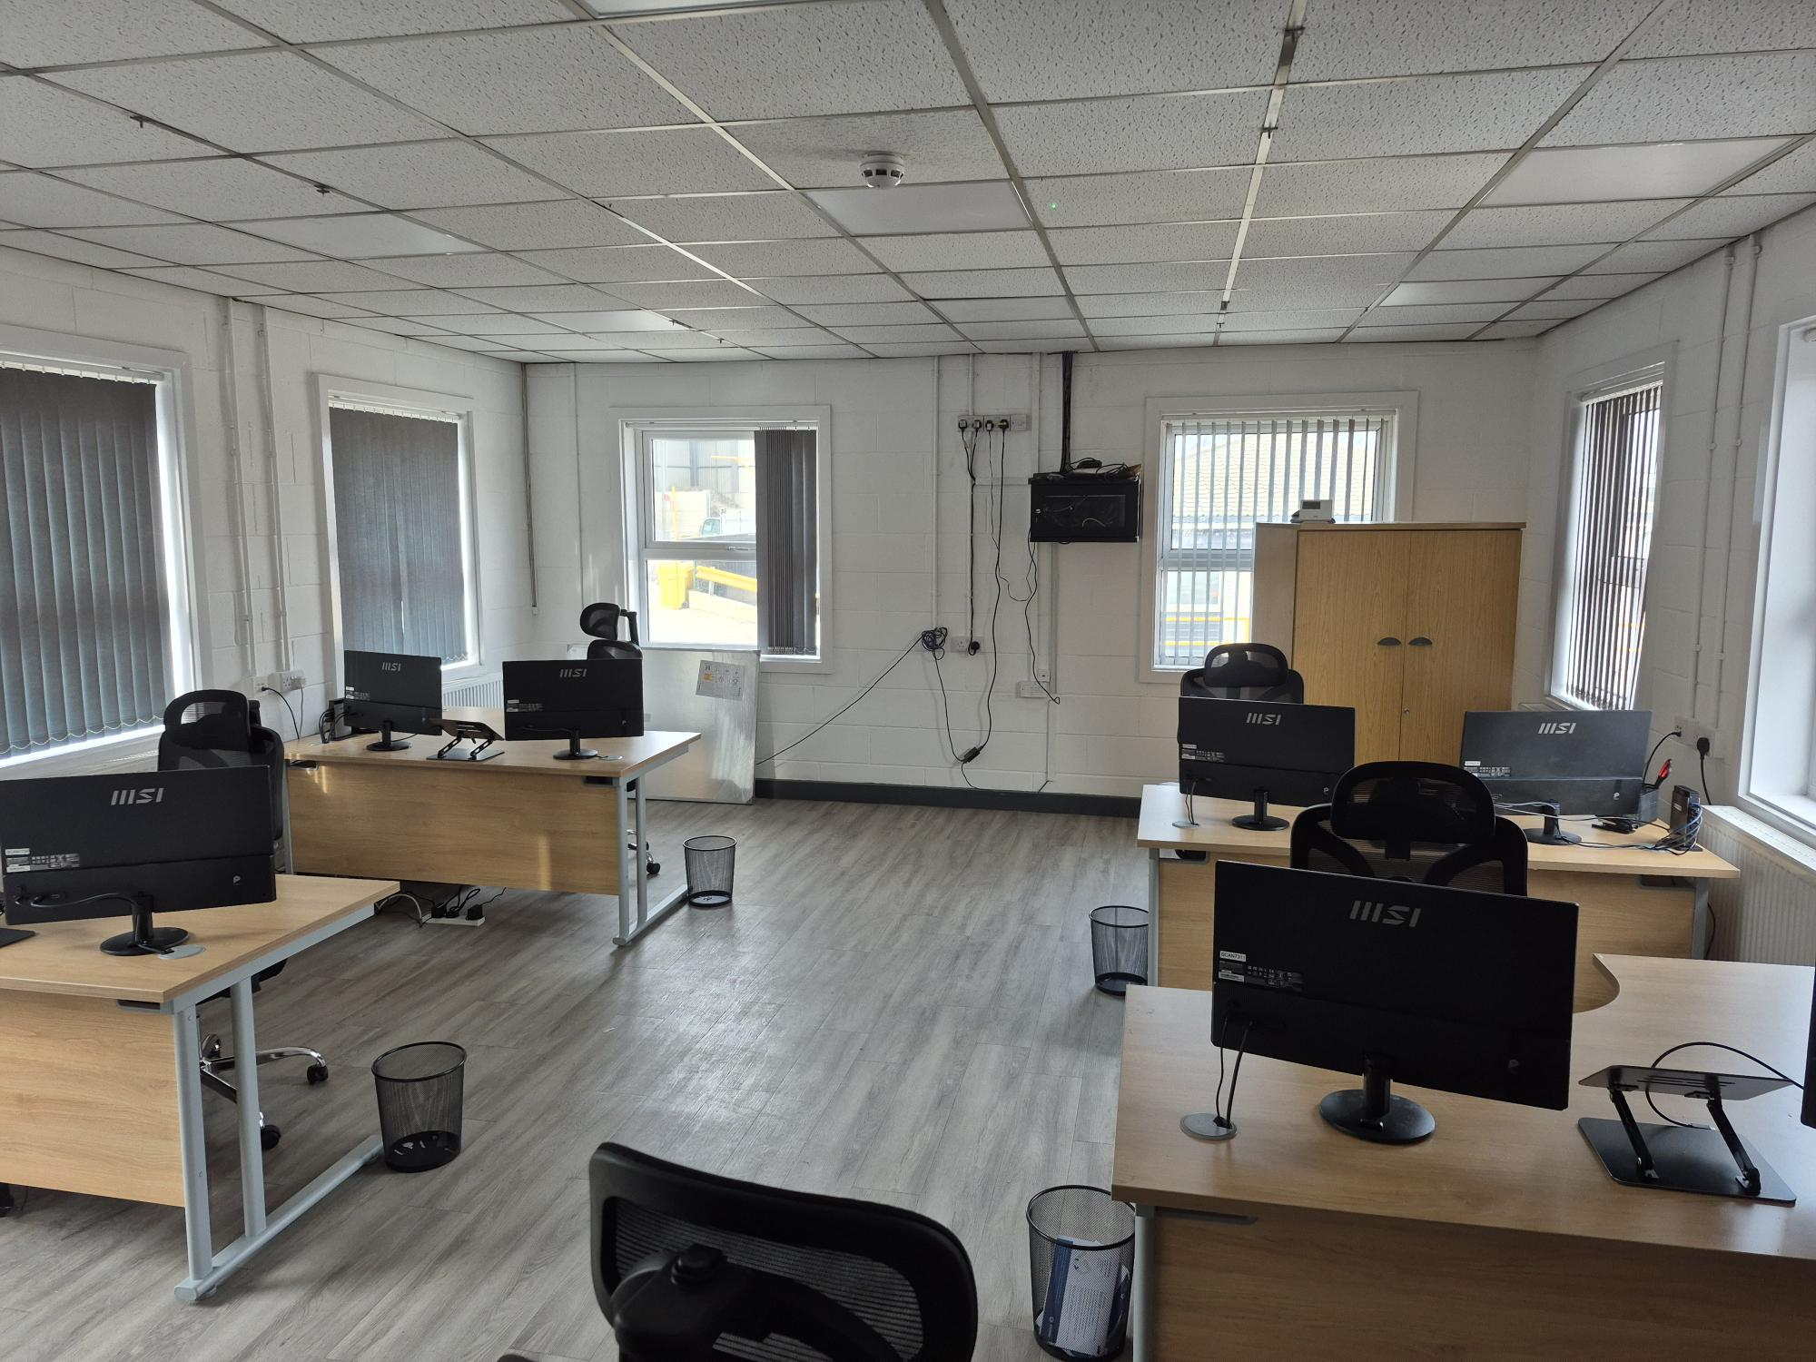
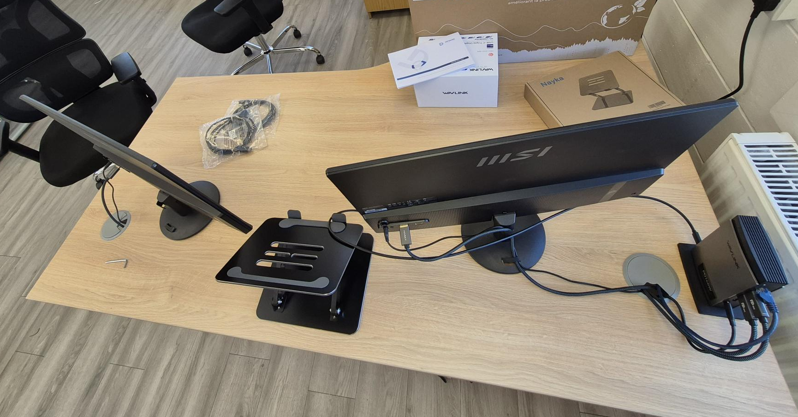
New Office - AFTER

Slide 12
Conclusion
Overall, I have found this placement very useful to me, as I’ve been able to enhance my skills as a software developer by deploying a self-coded application and publishing it into a business environment. Alongside this I’ve also gained crucial communication skills, as I’ve worked with a diverse range of people during my placement time (both senior and non-senior)
Currently I’m still employed with Scanmetals UK, and will be up until mid August, and I plan to provide as much support to the company as possible.

